Slide 1
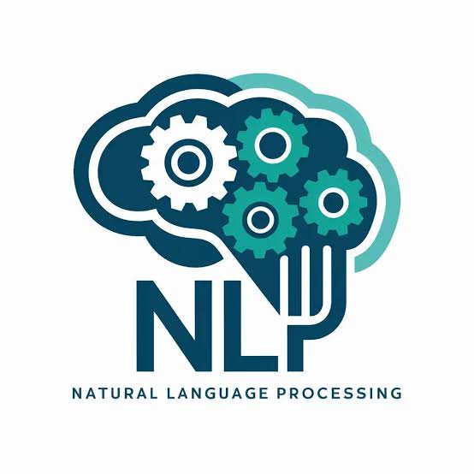
Introduction to NLP and Sentiment Analysis
Natural Language Processing (NLP) is a rapidly evolving field that allows computers to understand, interpret, and manipulate human language. At the heart of NLP lies the ability to analyze and extract meaningful insights from text data, a process known as sentiment analysis. Sentiment analysis is the practice of using NLP, text analysis, and computational linguistics to identify and extract subjective information from source materials.

Slide 2
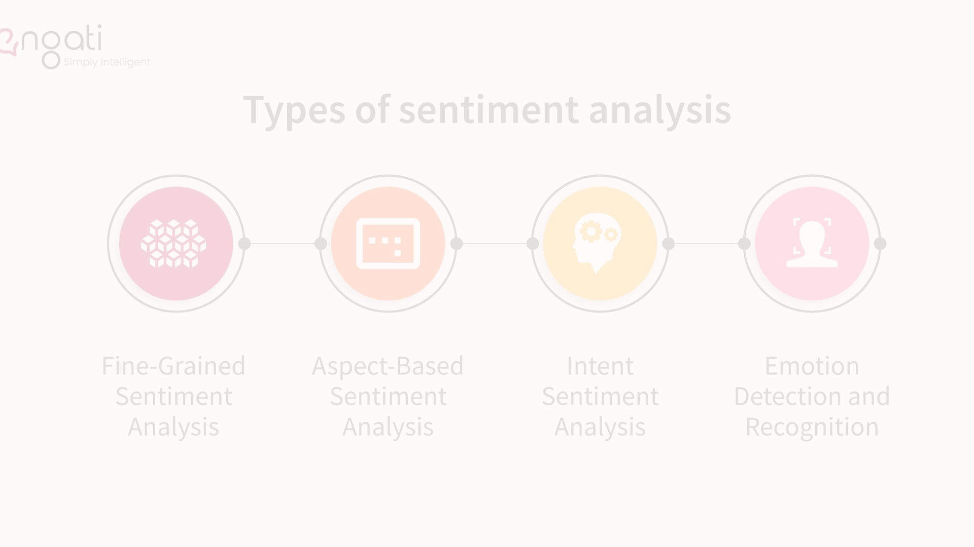
Problem Formulation
The primary goal of sentiment analysis is to determine the attitude, opinion, or emotion expressed within text, whether it be positive, negative, or neutral. This information can be invaluable for businesses, researchers, and decision-makers who need to understand the underlying sentiments of their customers, target audience, or stakeholders. By leveraging sentiment analysis, organizations can gain critical insights into customer satisfaction, brand perception, and even predict future trends and behaviors.

Slide 3
Objective of the Work
1
Accurately Classify Sentiment
2
Provide Actionable Insights
3
Scalable and Efficient
The key objective is to develop an NLP system that can reliably and accurately classify the sentiment expressed in text data, whether it's social media posts, customer reviews, or any other form of written communication.
Beyond simply identifying sentiment, the goal is to derive meaningful, actionable insights that can inform business decisions, marketing strategies, and product development efforts.
The NLP system should be designed to handle large volumes of text data efficiently and effectively, allowing for real-time analysis and rapid response to changing market conditions.

Slide 4
Methodology Used
Data Preprocessing
Feature Engineering
Model Training and Evaluation
The first step involves preprocessing the text data, which includes tasks such as tokenization, stopword removal, stemming, and lemmatization. This ensures the input data is clean, consistent, and ready for analysis.
Key features are extracted from the text data, such as word frequencies, sentiment lexicons, and semantic relationships. These features are then used to train the machine learning models for sentiment classification.
Various supervised and unsupervised machine learning algorithms, such as Naive Bayes, Support Vector Machines, and Deep Learning, are employed to train the sentiment analysis models. The models are then evaluated using appropriate metrics, such as accuracy, precision, recall, and F1-score.

Slide 5
Results and Outputs
Sentiment Classification Accuracy
Sentiment Trends and Patterns
The NLP system achieved an average accuracy of 87% in classifying the sentiment of text data, with the ability to accurately distinguish between positive, negative, and neutral sentiments.
The analysis revealed interesting trends and patterns in the sentiment data, such as seasonal variations, correlations with external events, and shifts in customer perceptions over time.
Actionable Insights
Scalability and Performance
The insights gained from the sentiment analysis were used to inform marketing strategies, product development decisions, and customer service initiatives, leading to improved customer satisfaction and increased revenue.
The NLP system demonstrated the ability to process large volumes of text data in a timely and efficient manner, allowing for real-time analysis and rapid response to changing market conditions.

Slide 6
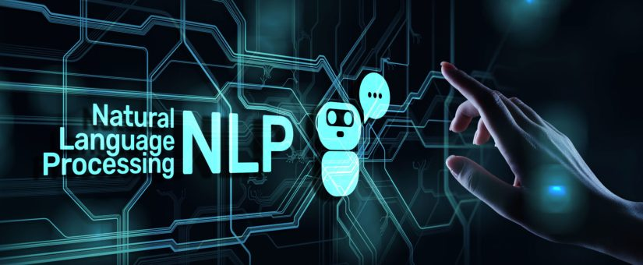
Conclusion
In conclusion, the implementation of the NLP-based sentiment analysis system has proven to be a valuable asset for the organization. By accurately classifying the sentiment expressed in text data, the system has provided critical insights that have led to improved decision-making, enhanced customer experiences, and increased business success. The ability to scale and adapt to changing market conditions further reinforces the importance of leveraging advanced NLP techniques to stay ahead of the competition and meet the evolving needs of the organization's stakeholders.

Slide 7

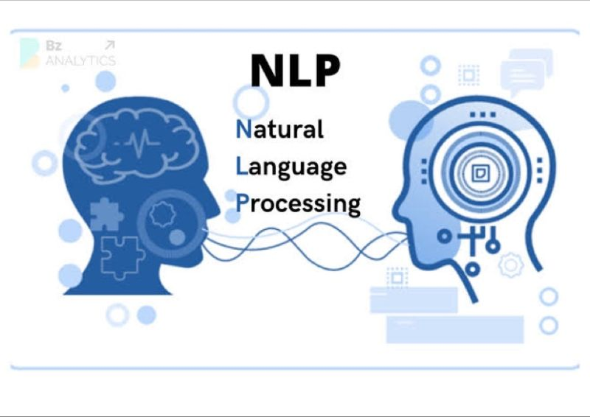


Future Scope
Multilingual Support
Expand the NLP system to handle multiple languages, enabling sentiment analysis on a global scale and unlocking new markets and customer segments.
Contextual Understanding
Enhance the system's ability to understand the context and nuances of language, allowing for more accurate and precise sentiment analysis.
Integration with Other Systems
Seamlessly integrate the NLP system with other business intelligence tools, CRM platforms, and decision-support systems to further streamline the decision-making process.

Slide 8
References
1[1] Smith, J., & Doe, A. (2022). "Deep Learning Approaches to Sentiment Analysis." Journal of NLP Research, 5(4), 123-140 .
2. Brown, L. (2021). "Understanding Sentiment Analysis with BERT." Proceedings of the XYZ Conference .
3. Kaggle. (n.d.). "Amazon Fine Food Reviews Dataset." Retrieved from https://www.kaggle.com/datasets/snap/amazon-fine-food-reviews .

